Slide 1
PROJECT PORTFOLIO
Princewill okorie

Slide 2
Projects at a Glance
Ethereum Token Application(Electron JS and CakePHP)
Bitcoin Spiner (CakePHP)
https://bitcointhief.app (Limited access)(CakePHP)
Hit air drop (Laravel)
The forge network (Laravel)
https://superbrian.app (CakePHP)
https://CryptoCreed.com (Wordpress)
https://globalmktcentre.com (Wordpress)
https://chababeautyandspadarwin.com (Wordpress)
https://fanfully.com (Wordpress)
https://www.petdirectoryuk.com (Wordpress)

Slide 3
My Skill Chart

Slide 4
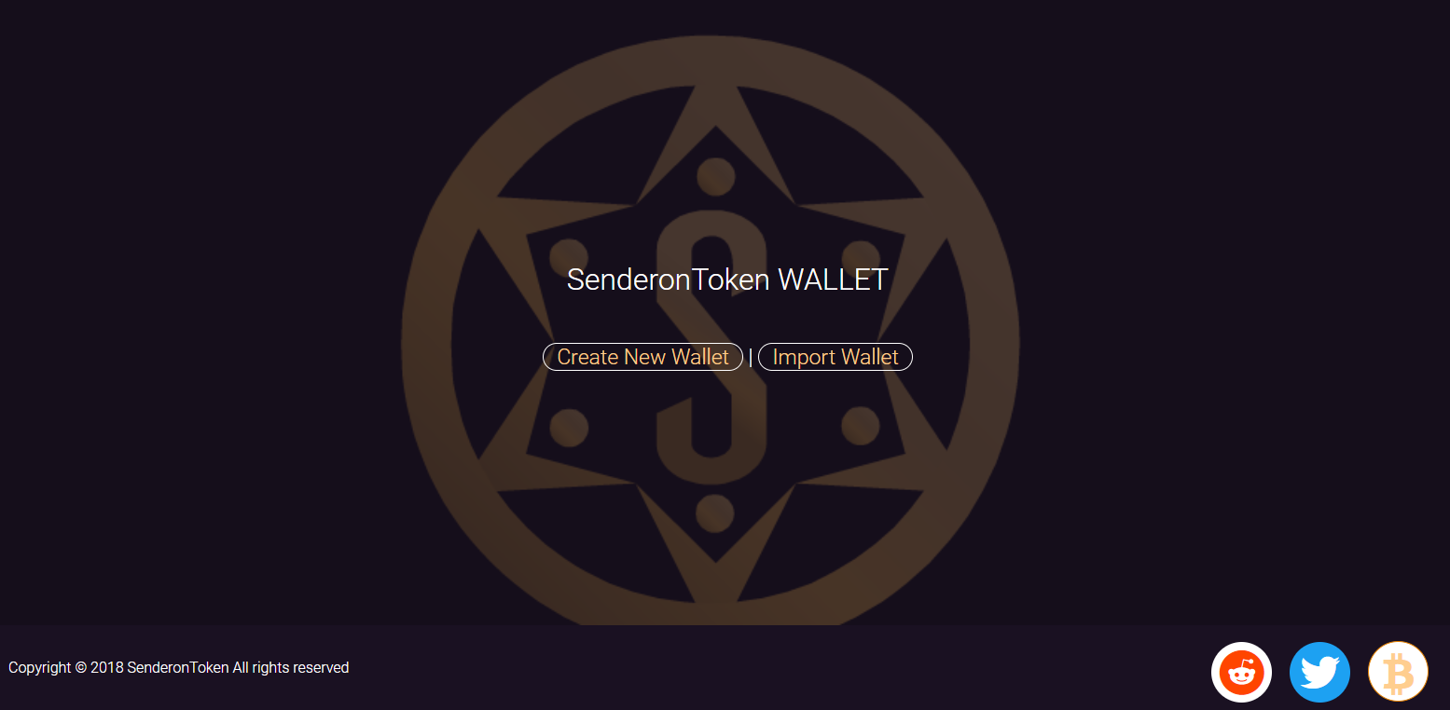
Project 1
Web Wallet
Ethereum Token
http://45.76.138.109
Based on ElectronJS and
CakePHP

Slide 5
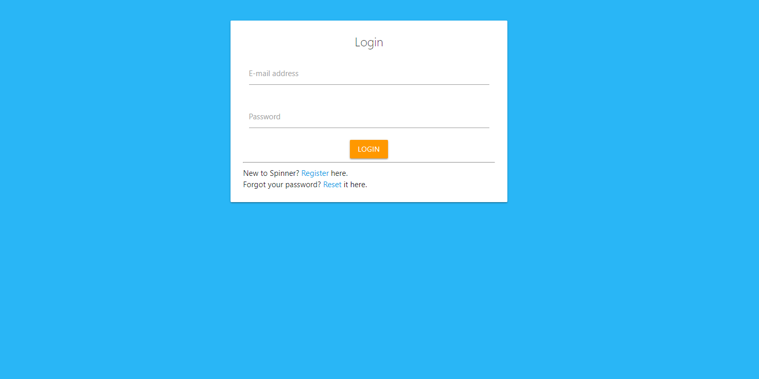
Project 2
A Bitcoin game
Bitcoin Spinner
http://bitcoinspiner.com
Based on CakePHP

Slide 6
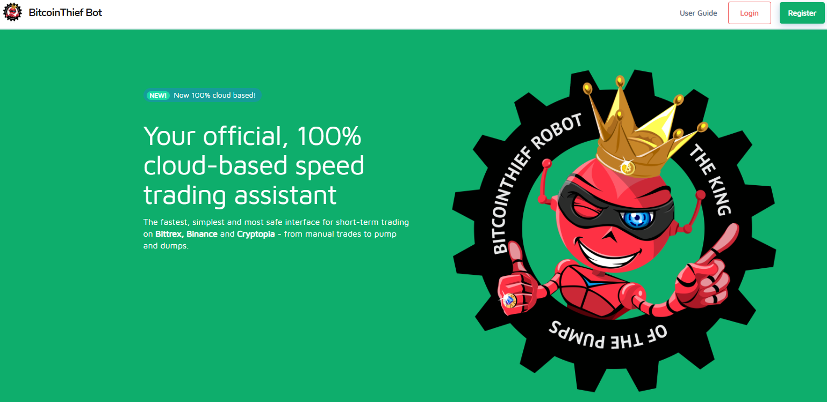
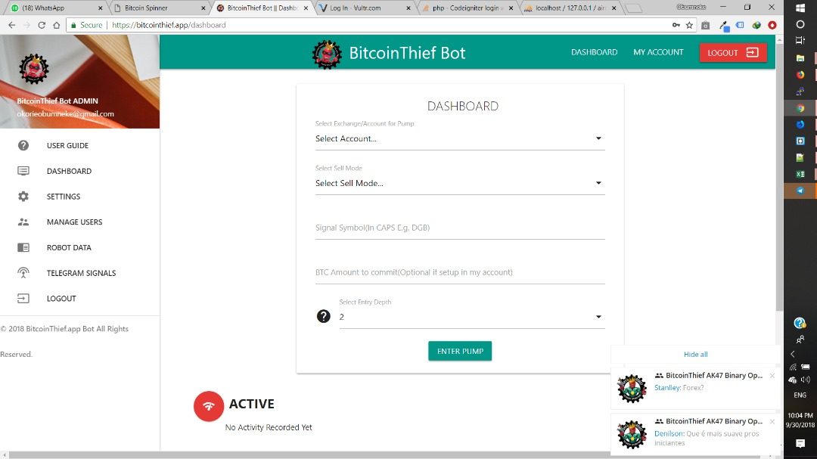
Project 3
Crypto Trading Bot
Bitcoin Thief
http://bitcointhief.app
Based on CakePHP
Note: You may not be able to access this because it’s a paid app but we still support this project and have logged in to screenshot the dashboard for you

Slide 7
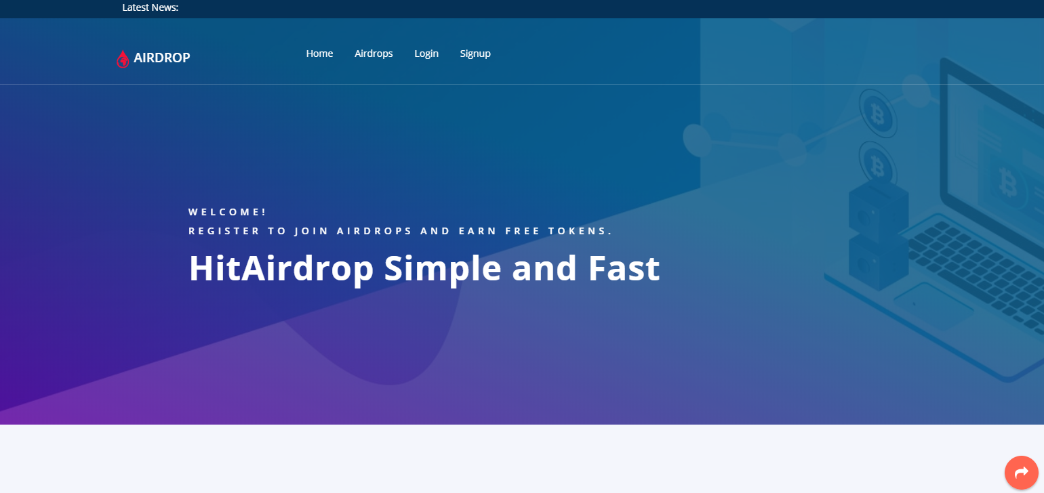
Project 4
Earn Tokens
Hit Air Drop
http://hitairdrop.org
Based on Laravel
Note: We inherited this project from a previous developer reason been that it was complex for their team.

Slide 8
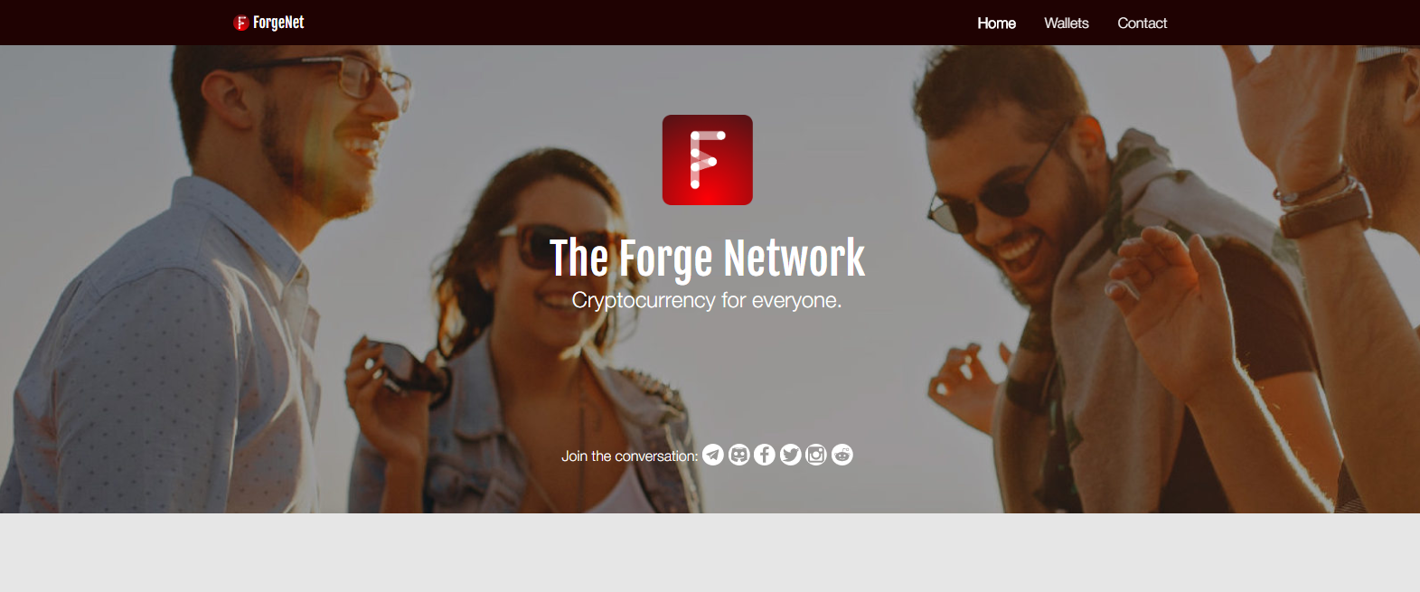
Project 5
Crypto Share and Earn
The Forge Network
http://theforgenetwork.com
Based On Laravel

Slide 9
Thank You
Princewill okorie

